Slide 1

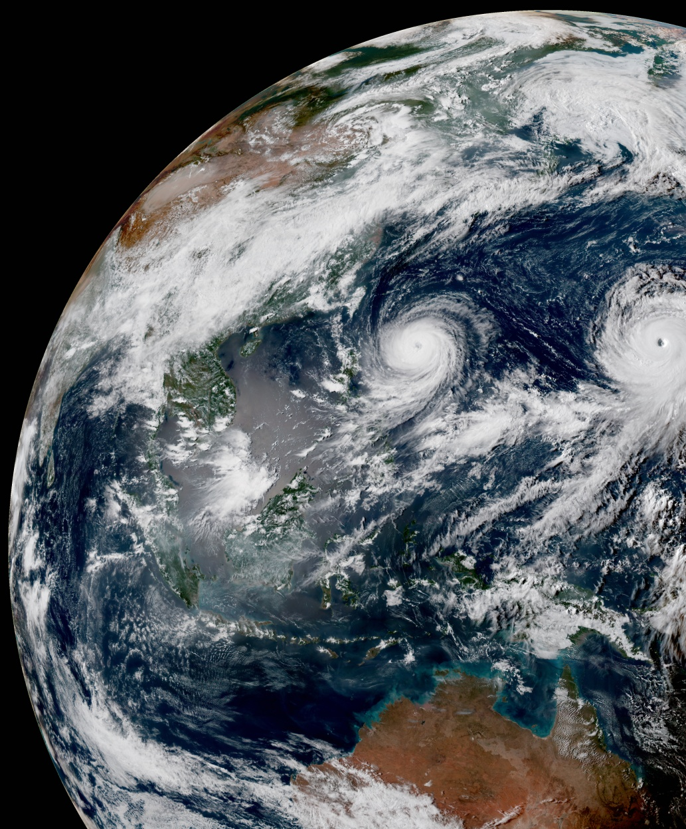
Introduction to Data Assimilation François Vandenberghe Hui Shao Hailing Zhang
Joint Center for Satellite Data Assimilation
UCAR/COSMIC ACCESS Workshop, 15 -18 August 2023 , Boulder, CO

Slide 2

Outline
Numerical Weather Prediction
Observations
Models
Data assimilation methods explained using Bayes Theorem
Components of data assimilation system
JEDI data assimilation system (used in the hands-on session)
GNSS Radio Occultation assimilation

Slide 3
Outline
Numerical Weather Prediction
Observations
Models
Data assimilation methods explained using Bayes Theorem
Components of data assimilation system
JEDI data assimilation system (used in the hands-on session)
GNSS Radio Occultation assimilation

Slide 4
What matters in Numerical Weather Prediction?
Model Resolution: The size of the pixel determines how local topographic effects are accounted for.
Parameterization: a NWP model contains a dynamic core and physical models: clouds, radiation, boundary layer, surface, soil, etc. Each sub-model depends on a wealth of parameters that need to be set. This is usually done by conducting field campaigns.
Observations/Data assimilation: real world observations are used to correct the model incomplete representation of the atmosphere
Computational efficiency: models must be faster than real time.

Slide 5
Why data assimilation matters?
Improvements of forecast skills in days at ECMWF
Notes:
Anomaly correlation (a measure of forecast accuracy) for 3, 5, 7 and 10 day forecasts evolution with years. The thick line indicates the mean for the Northern hemisphere and the thin line indicates the mean for the Southern hemisphere. Forecast accuracy has increased over the years for both the Northern and Southern hemisphere. For example the same accuracy (70% threshold) of day 5 in 1985 was reached by day 7 in 2005. Since the same (global) model is used for both hemispheres, the difference between Southern and Northern hemispheres is attributed to the lack of observations in the Southern hemisphere (see previous slide). The reduction of the Northern/Southern hemisphere difference is attributed to the satellite observations, which are hemisphere independent, and progress in data assimilation.

Slide 6
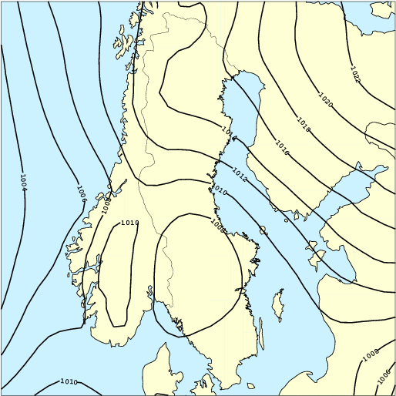
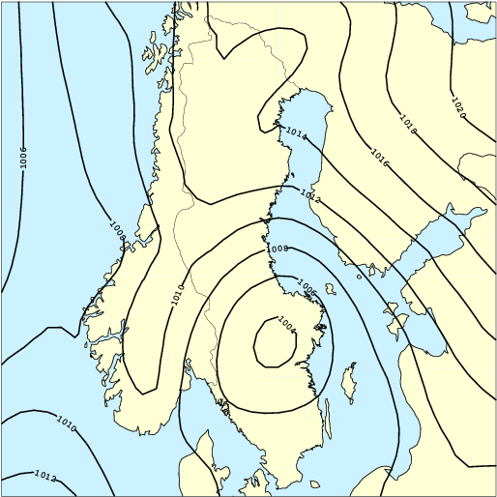
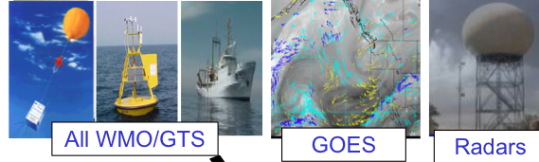
Numerical Weather Prediction
Model
Analysis
Data
Assimilation
Forecast [t₀-12hr, t₀]
observations
Forecast [t₀, t_{0+12hr}]
Notes:
6
The analysis consists in correcting the model forecast with real observations (data assimilation)

Slide 7
The Analysis/Forecast cycle
observations
Analysis
(assimilation)
forecast
00UTC
day 0
12UTC
day 0
00UTC
day+1
12UTC
day+1
00UTC
day+2
Analysis
(assimilation)
forecast
observations
FDDA is based on observation-nudging (Newtonian relaxation) technique Stauffer and Seaman (1995), ( See ~20 pubs at:
https://www.rap.ucar.edu/projects/4dwx/resources/publications.html )
forecast
Four dimensional data assimilation
Notes:
The forecast/analysis cycling scheme used on real-time numerical weather prediction model

Slide 8
Data Assimilation
model
Φ
obs
after
assim
model
correction
before
assim
initial
conditions
forecast
t
Data Assimilation corrects the model initial conditions
so that model trajectory “best” fits the observations
Notes:
Data assimilation corrects the model trajectory based on the observation information. This is an animation, please use the presentation mode.

Slide 9
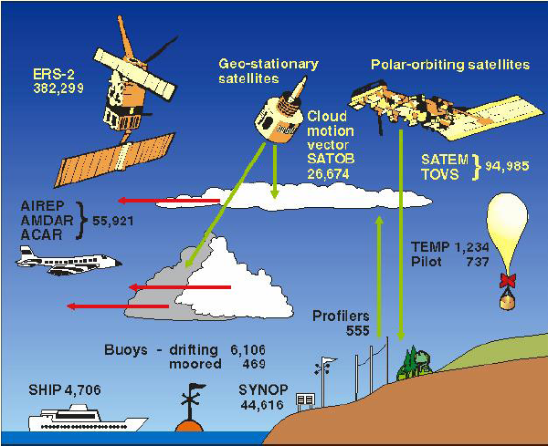
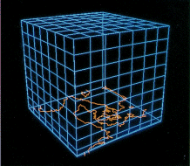
observations
~105-106
model state
~107
Notes:
There usually 10 or 100 more model grid points (degrees of freedom) than observations

Slide 10
Outline
Numerical Weather Prediction
Observations
Models
Data assimilation methods explained using Bayes Theorem
Components of data assimilation system
JEDI data assimilation system (used in the hands-on session)
GNSS Radio Occultation assimilation

Slide 11
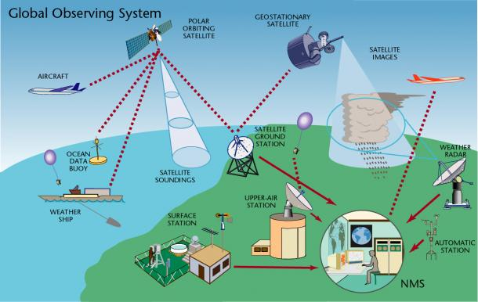
Global observing system
Surface observations
Upper-air observations
Marine observations
Aircraft-based observations
Satellite observations
Weather Radar observations
Other observation platforms
https://public.wmo.int/en/programmes/global-observing-system
In-Situ observations:
Direct measurement of state variables, but irregular in space and time
Remote sensing:
Indirect measurement, e.g., radiance, reflectivity, bending angle, refraction, etc.

Slide 12
Upper-air observations
Notes:
World distribution of various types of observations

Slide 13
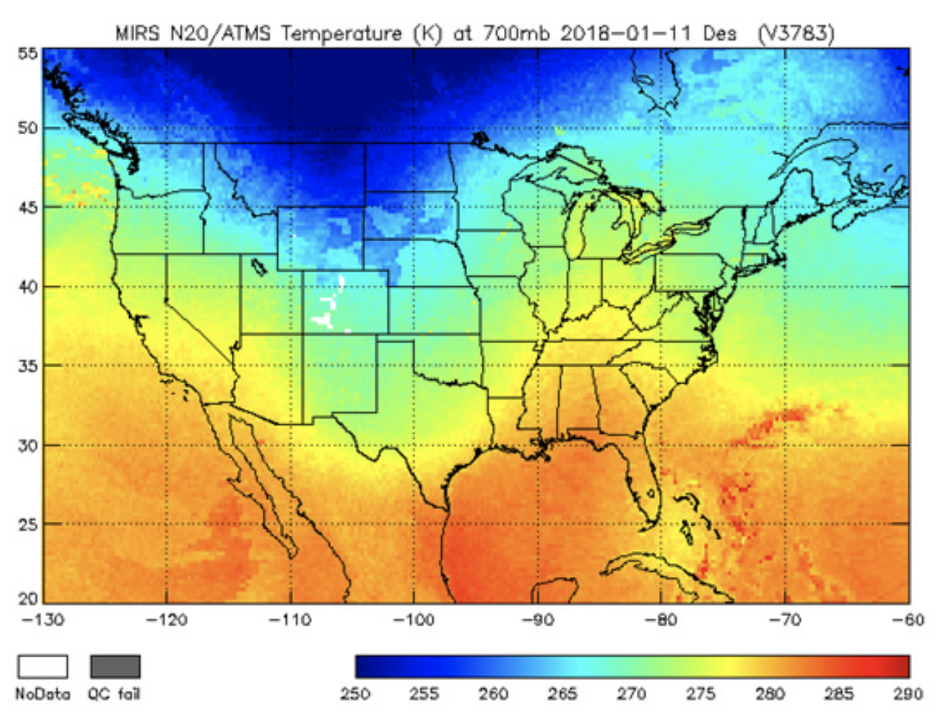
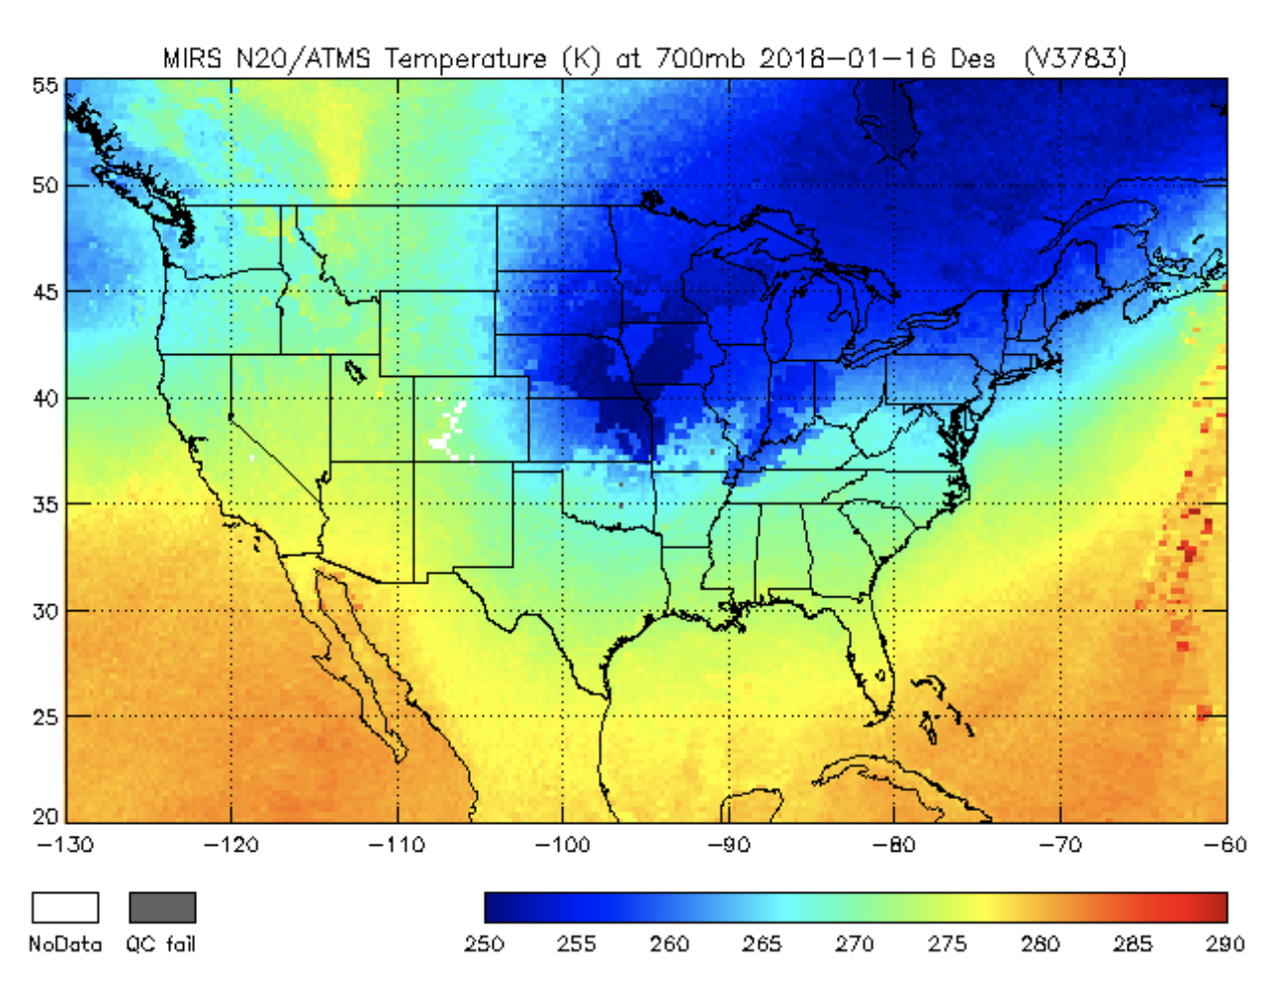
Satellite Observations (ATMS)
NOAA-20 captured these two images of North America five days apart (January 11, 2018 and January 16, 2018). The difference in temperature between the two dates is more than 54 degrees Fahrenheit (30 degrees Celsius), which was confirmed by the surface temperature observations.

Slide 14
The satellite era:1979-present
log(data count)
satellites
upper-air
surface
1900
1938
1957
1979
2012
Notes:
The exponential growth of satellite observations. Only a very small fractions of the reported satellite observations are actually assimilated.

Slide 15
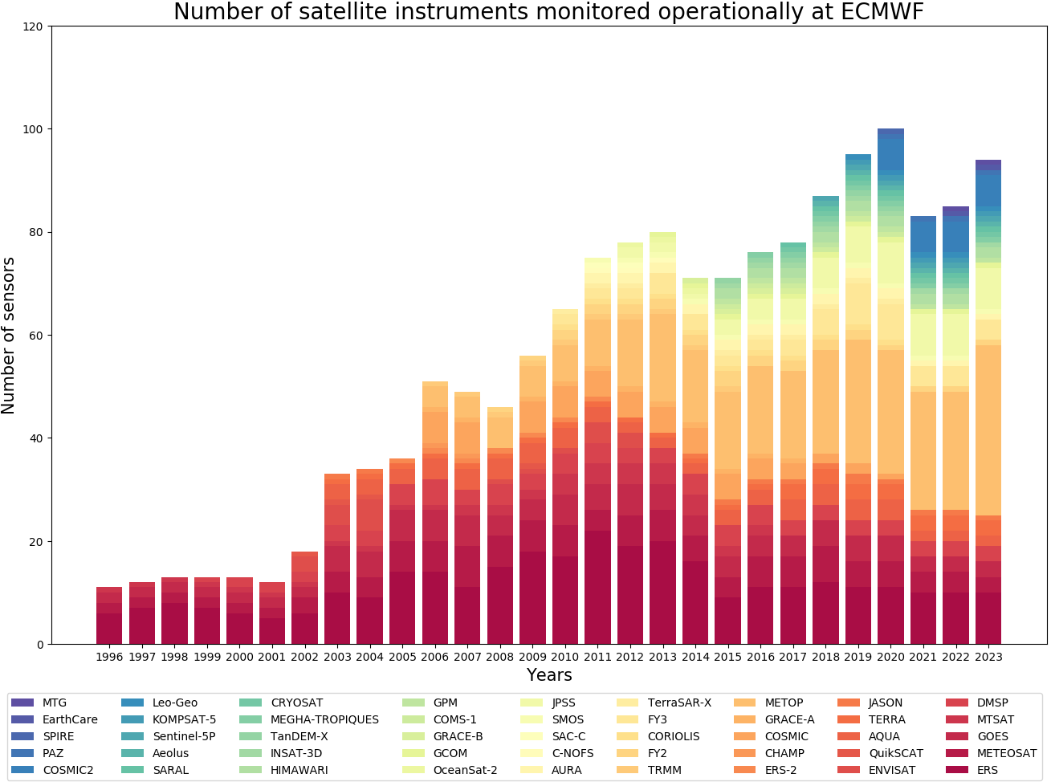
Satellite Missions since 1996
From S. Healy, ECMWF
Notes:
The exponential growth of satellite observations. Only a very small fractions of the reported satellite observations are actually assimilated.

Slide 16
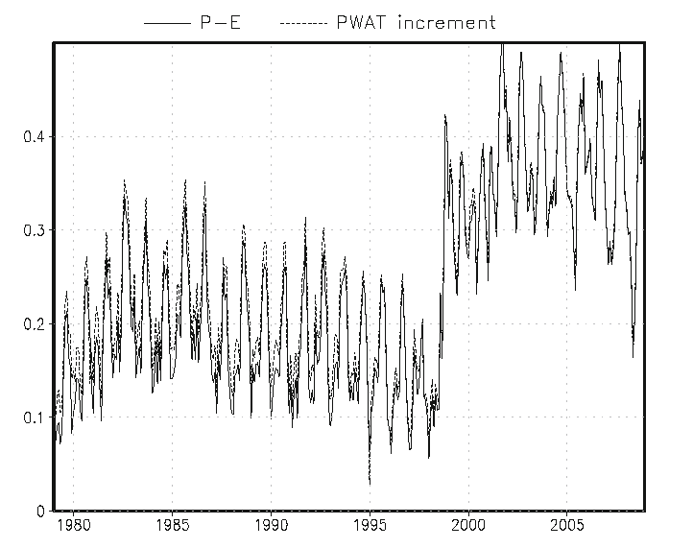
Sensors Calibration
TOVS > ATOVS
AMSU-A
NOAA-15 Oct 1998
NOAA-16 Feb 2001
NOAA 16 -->
NOAA 15 -->
Climate Forecast System Reanalysis
mean precipitable water analysis increment
Notes:
Precipitable water is the total amount of water vapor in the column of atmosphere (a integrated measure of moisture)
The analysis increment is the correction that results from data assimilation
The Climate Forecast System Reanalysis project is the 30 year global reanalysis at 0.5° conducted by NOAA

Slide 17
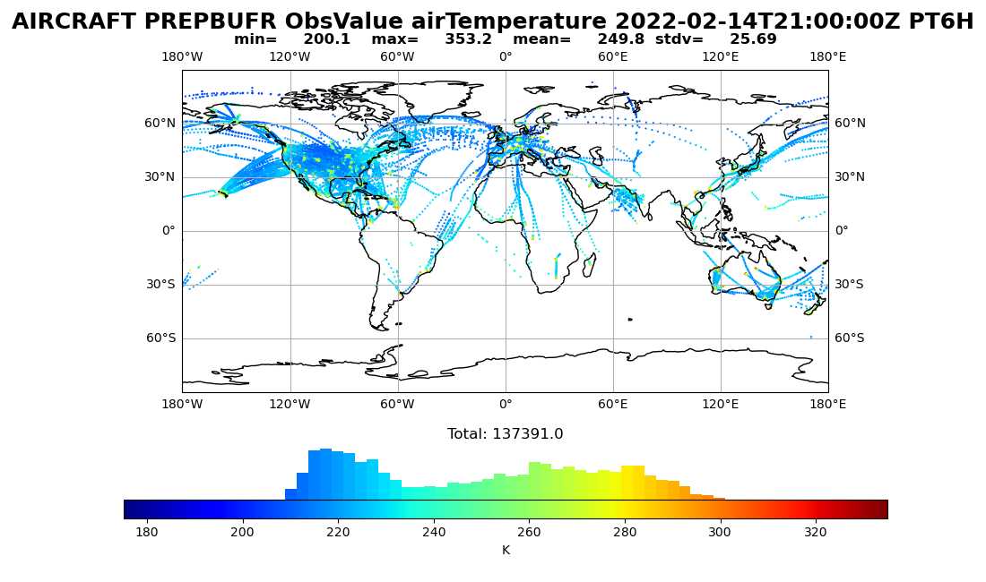
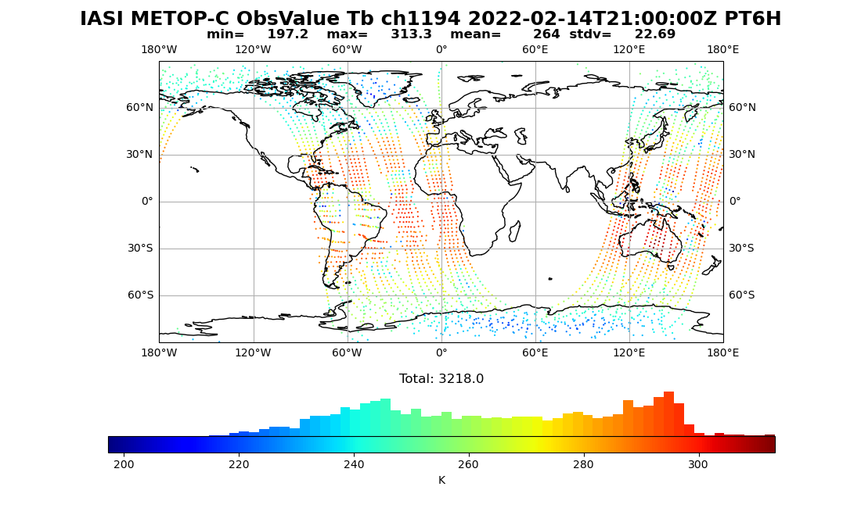
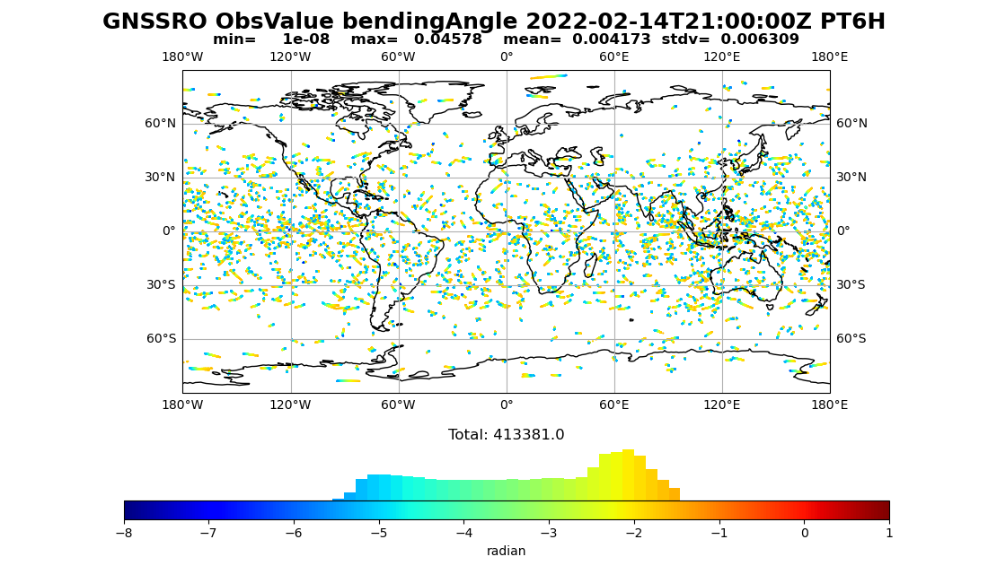
Limitations of observations
Only observe part of the state (spatial and temporal)
Observe a nonlinear function of the state, e.g., radiance, bending angle
Observations are not perfect: uncertainties and biases

Slide 18
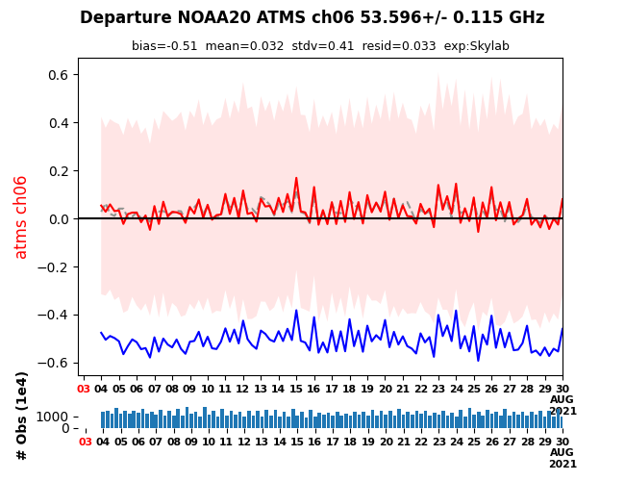
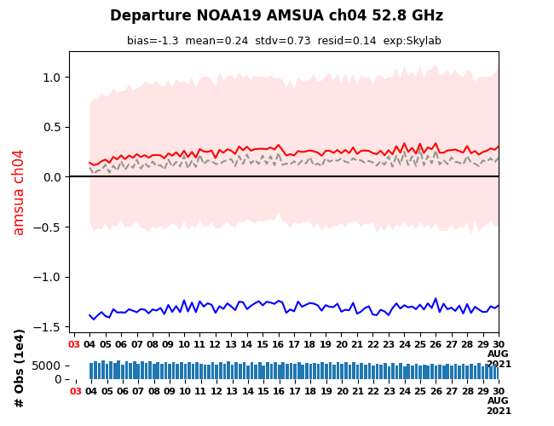
Experiment Monitoring
Observation bias
Microwave Sounders ATMS and AMSU-A show stable global fits
fit to background (red) and analysis (gray-dashed); un-bias corrected (blue); stdv of fit to background (red shading)
O-B after bias correction
O-A
O-B before bias correction
ATMS
AMSU-A
O-B: Observation minus Background
O-A: Observation minus Analysis

Slide 19
Outline
Numerical Weather Prediction
Observations
Models
Data assimilation methods explained using Bayes Theorem
Components of data assimilation system
JEDI data assimilation system (used in the hands-on session)
GNSS Radio Occultation assimilation

Slide 20
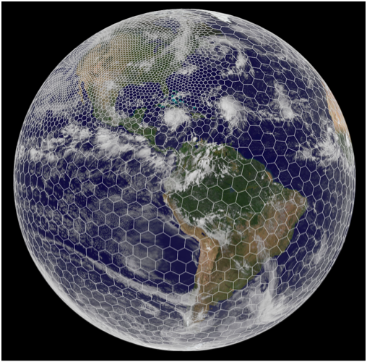
Numerical Weather Prediction Models
Numerically solve the fluid dynamics (primitive) equations on a grid
Grids can be global or regional

Slide 21
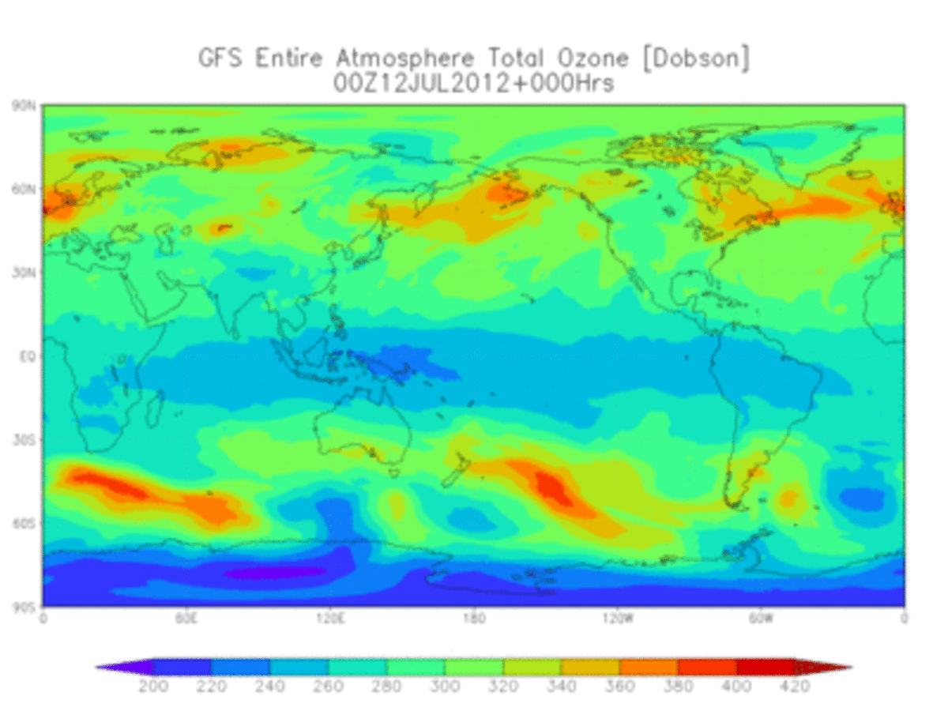
Numerical Prediction Models
Gridded
Global, regional coverage
Temporal coverage
Dynamics and physics
Balance and constraint
https://www.ncei.noaa.gov/products/weather-climate-models/global-forecast

Slide 22
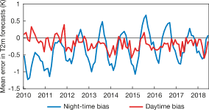
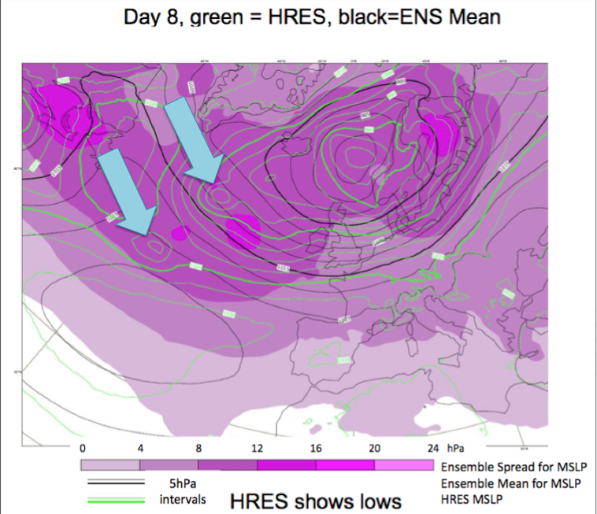
Limitations of model forecast
Representativeness, e.g., nonlinearity, parameterization, scales, resolutions, etc.
Random errors
Systematic errors
Night-time (00 UTC) and daytime (12 UTC) bias of the ECMWF high-resolution T2m forecast in Europe from verification against SYNOP observations. Stations for which the model elevation differs by more than 100 m from the true elevation, and stations where the nearest grid point is an ocean point have not been included. Lead times are 60 hours and 72 hours, respectively.
https://www.ecmwf.int
An example of forecast mean sea level pressure (taken from part of an ECMWF mean and spread chart) highlighting the difference between the HRES (Green) and the ensemble mean (EM, black). Absolute spread of ensemble members is shown by shading. The ensemble mean is the average over all ensemble members. It smooths the flow more in areas of large uncertainty (spread), something that cannot be achieved with a simple filtering of single forecast. If there is large spread, the ensemble mean can be a rather weak pattern and may not represent any of the possible states.

Slide 23
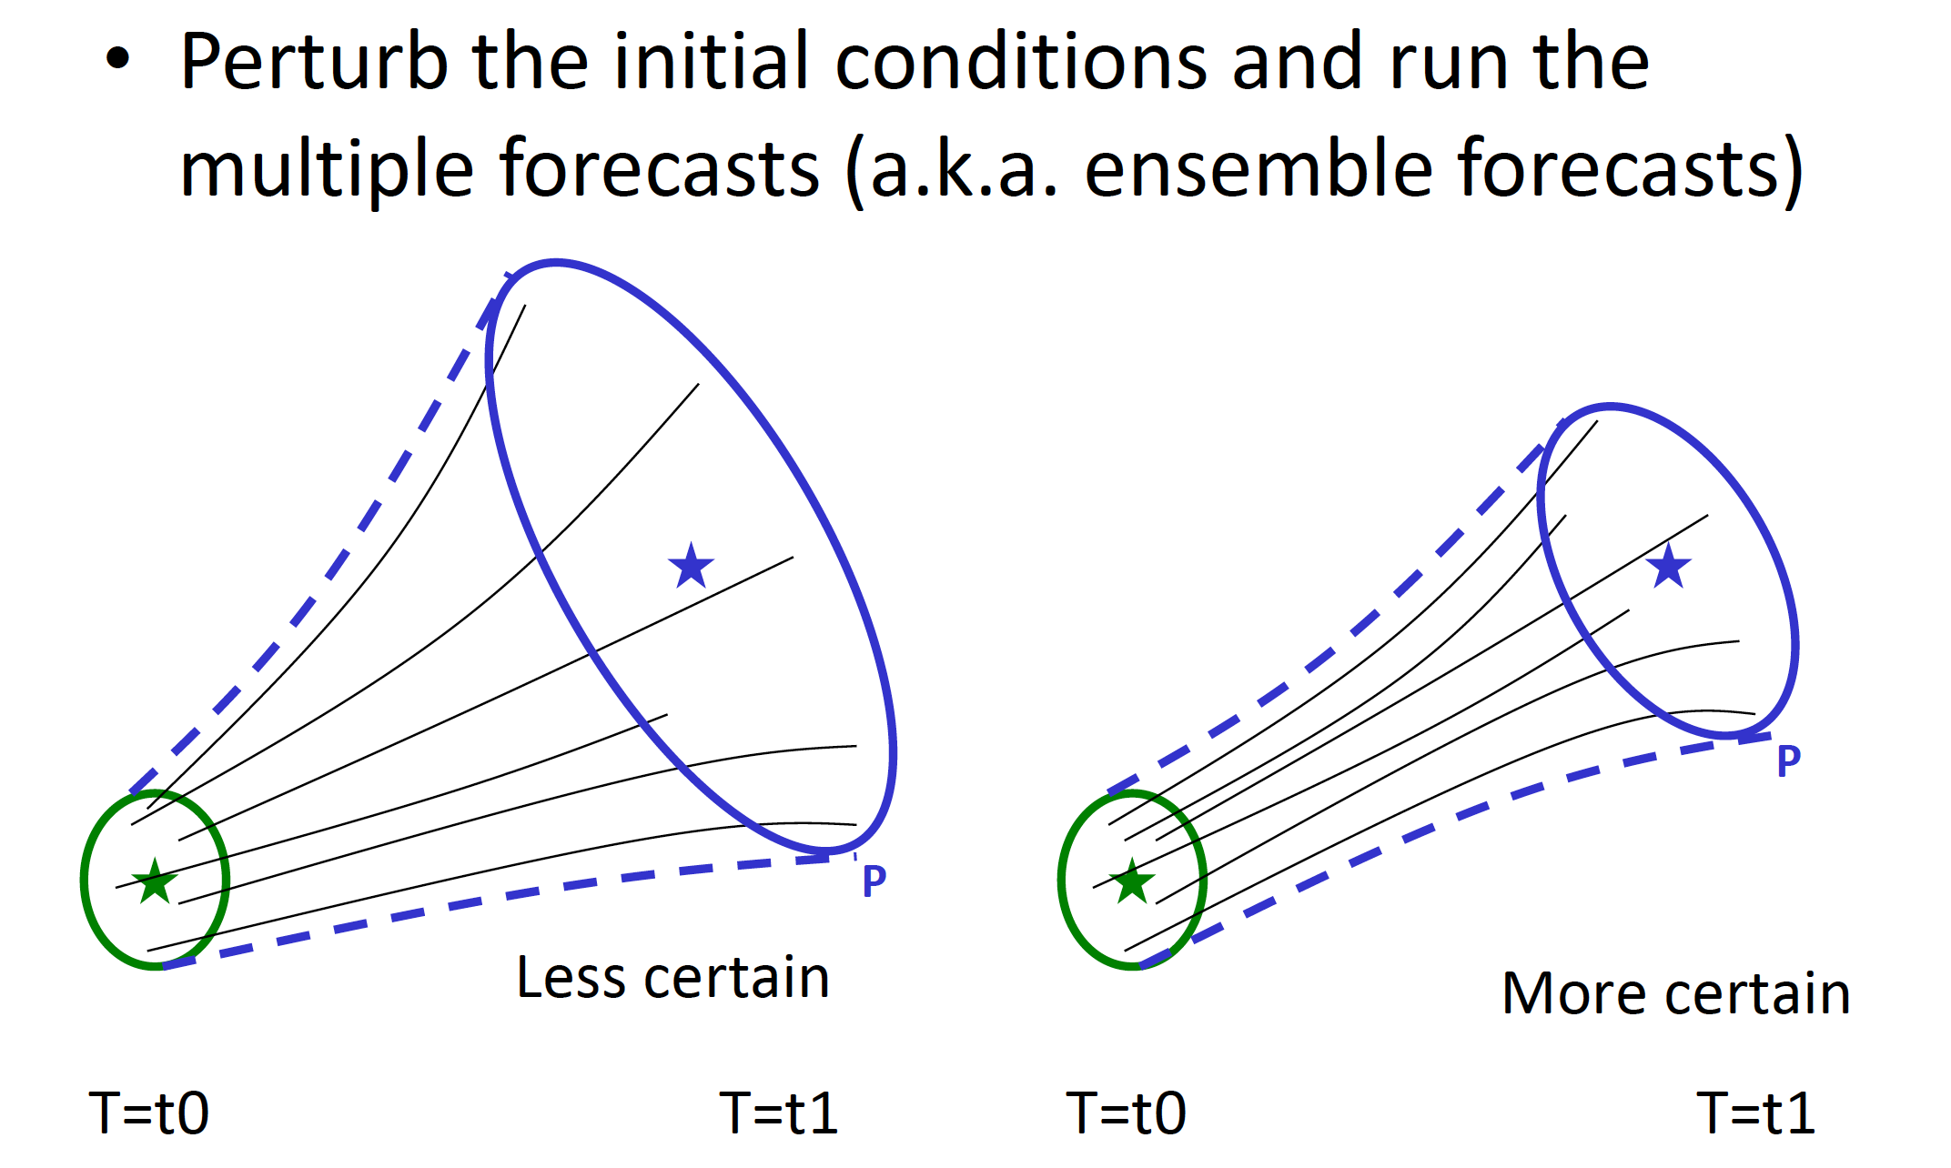
Sensitivity to initial conditions
Even if the model is perfect, the state of the system –at any time- is completely determined by the initial conditions.
(Javier Amezcua, 2018)

Slide 24
Outline
Numerical Weather Prediction
Observations
Models
Data assimilation methods explained using Bayes Theorem
Components of data assimilation system
JEDI data assimilation system (used in the hands-on session)
GNSS Radio Occultation assimilation

Slide 25
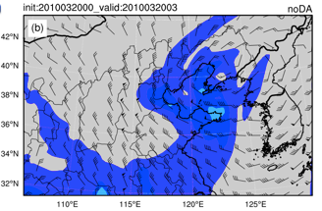
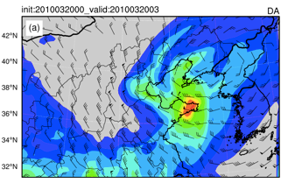
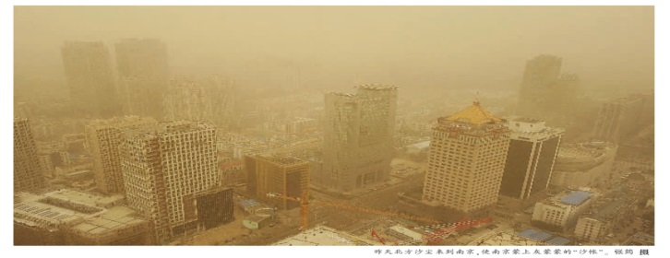
Data Assimilation
+
=
Observations (y): provide an incomplete description of the atmospheric state, but bring up to date information
Background (x_{b}) (a prior): gives a complete description of the atmosphere, but errors grow rapidly in time
Analysis (x_{a} at t=t₀)
Current
Data assimilation: combines these two sources of information to produce an optimal (best) estimate of the atmospheric state
Forecast model
x_{a}= w_{b}x_{b} + w_{o}y = x_{b} + K(y-x_{b})
How to find optimal weighting for background information and observations?
Forecast
(x_{t})
Future
Notes:
“Data assimilation is an analysis technique in which the observed information is accumulated into the model state by taking advantage of consistency constraints with laws of time evolution and physical properties”-F. Bouttier and P. Courtier, ECWMF Data Assimilation Training, 1999
Primary objectives of data assimilation
Estimation of the current state
Forecast of the future state

Slide 26
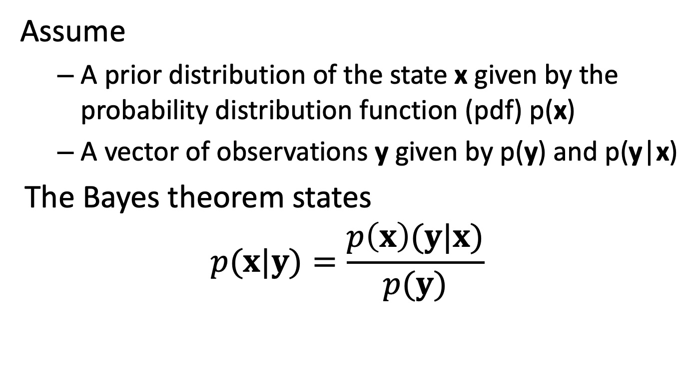
Bayes theorem

Slide 27

DA using Bayes Theorem
Prior: pdf of the state variables given the observations
Likelihood: pdf of the observations given a value of the state variables
Posterior: pdf of the state variables given the observations
Marginal pdf of the observations: usually act as a normalization constant
It is impossible to estimate these pdfs in large dimensional system.
Approximate solutions lead to data assimilation methods:
Variational methods: Maximum likelihood
Optimal interpolation (OI), Kalman-based methods: Minimum Variance

Slide 28
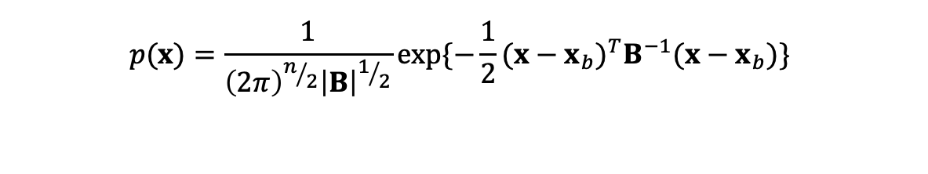
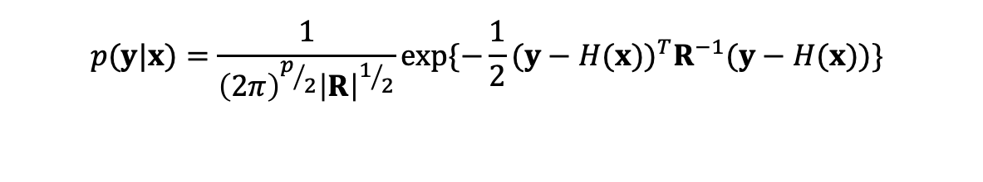
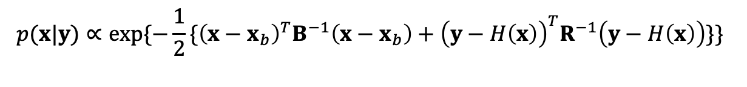
Gaussian Assumption
If we assume errors follow Gaussian distribution, the pdf can be determined by:
Prior
Likelihood
Posterior

Slide 29
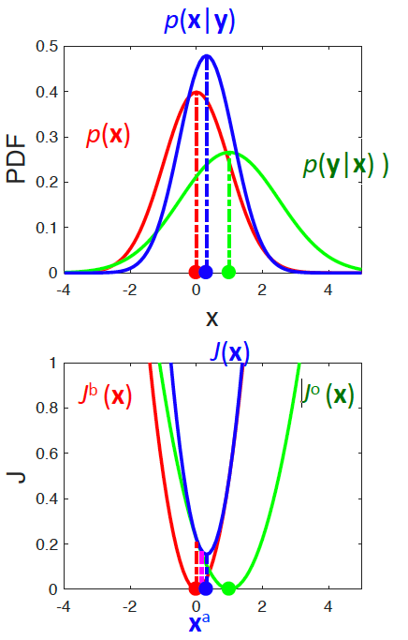
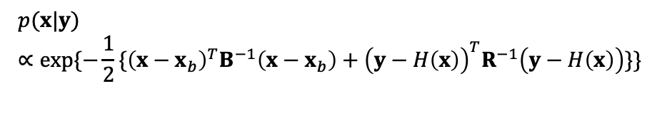
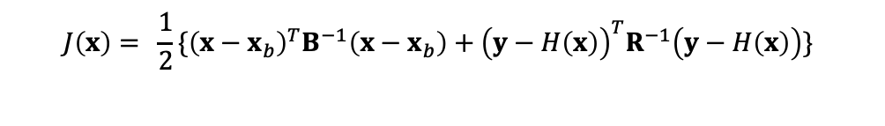
Finding the optimal X
Maximize
Minimize

Slide 30
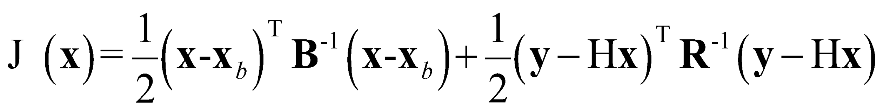
3D method: 3D-Var Cost Function
Analysis (model state)
Observation operator
Background
Observation error covariance
Background error covariance
Observations
Background term: J_{b}
Observation term: J_{o}
All observations are assumed to be instantaneous
-> Observations within a specified time window are assimilated at one time

Slide 31
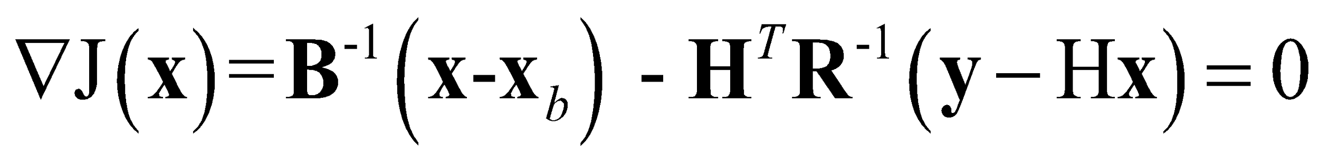
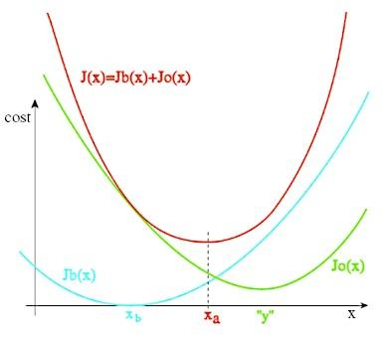
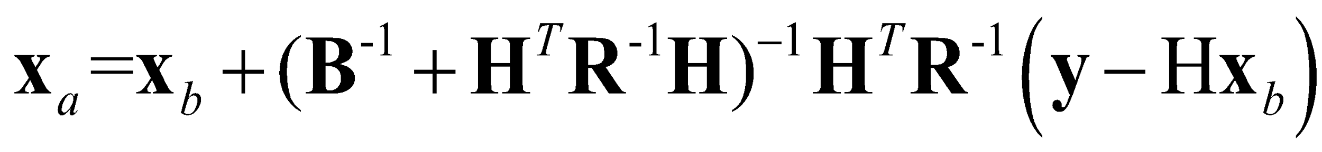
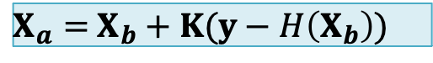
Minimizing Cost Function
Optimal x_{a} is obtained by minimizing the cost function
H^{T} is called the Adjoint of the linearized observation operator
Assuming state variable x and the final analysis x_{a} remains close enough, we can derive
Observation-based correction to background
A more generic expression for DA
Kalman gain matrix

Slide 32
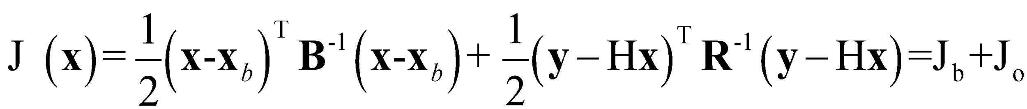
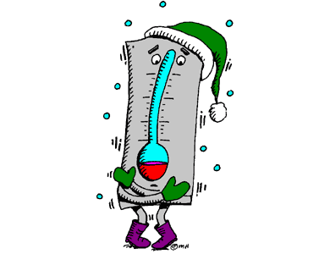
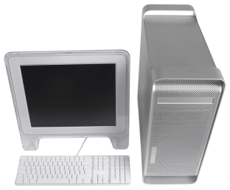
Example: One-point Observation
A scalar example: x here represents the temperature (T) outside
J (T) = ½ (T-T_{b})σ_{B}⁻¹(T-T_{b}) +½(T_{o}-T)σ_{R}⁻¹(T_{o}-T)
T_{a}?
T_{o}=30F
σ_{R}=0.2F
T_{b}=32F
σ_{B}=0.8F

Slide 33
Example: One-point Observation (cont.)
Scalar example: What is the temperature analysis (x_{a}->T_{a})?
σ_{B}⁻¹(T_{a}-T_{b})-σ_{R}⁻¹(T_{o}-T_{a})=0
T_{a}=σ_{B}T_{o}(σ_{B}+σ_{R})⁻¹+σ_{R}T_{b}(σ_{B}+σ_{R})⁻¹=30.4F
T_{a}=30.4F
T_{o}=30F
σ_{R}=0.2F
T_{b}=32F
σ_{B}=0.8F

Slide 34
Outline
Numerical Weather Prediction
Observations
Models
Data assimilation methods explained using Bayes Theorem
Components of data assimilation system
JEDI data assimilation system (used in the hands-on session)
GNSS Radio Occultation assimilation

Slide 35
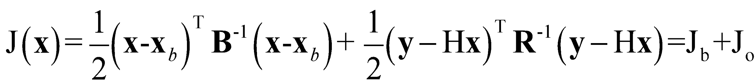
Observation Term (J_{o})
Observation operator: H
Most (traditional measurements)
3D interpolation
Some (non-traditional)
Complex function, e.g.,
Radiance= f(t,q), where f is a radiative transfer model
Radar Reflectivity = f(q_{r},q_{s},q_{h})
Bending angle = f (t, p, q, …)
Observation innovation: y-Hx
x
x
x
x
x
x
x
x
y
x
x
x
x
y
x
x
x
x

Slide 36
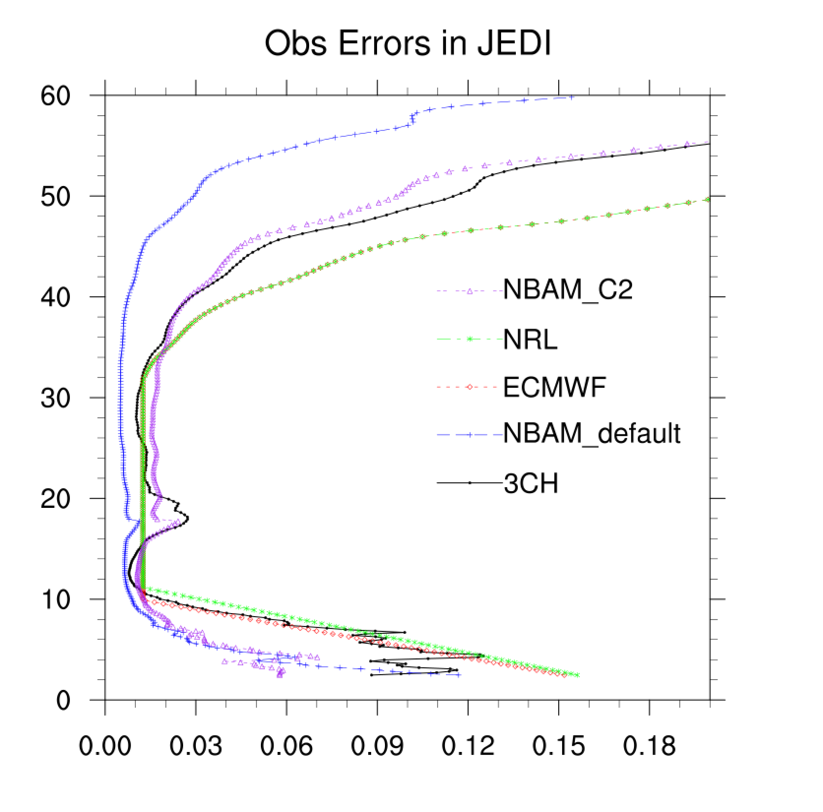
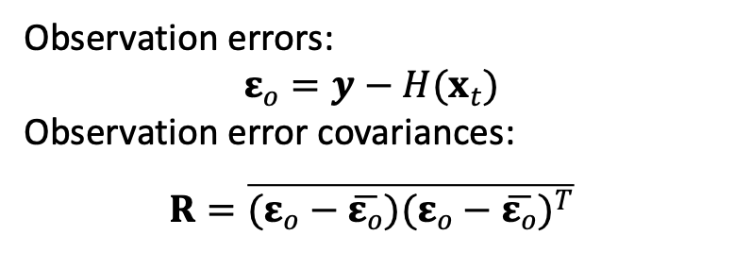
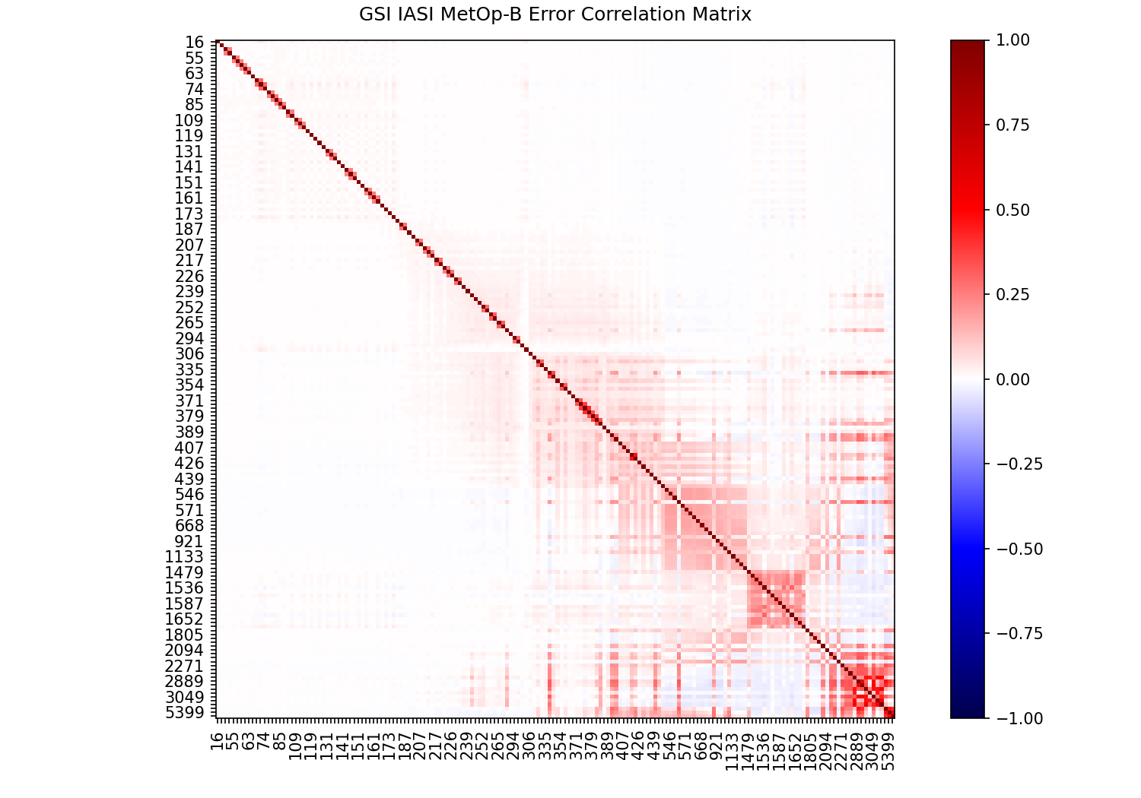
Observation error covariance: R
Observation errors contain
Errors in the observation process (instrumental errors, because the reported value is not a perfect image of reality)
Errors in the design of the operator H
Representativeness errors, i.e. discretization errors which prevent from being a perfect image of the true state
Observation error matrix can be estimated based on O(bservation)-B(ackgroud), O-A(nalysis) information (total error method, Desroziers et al (2005), 3CH, …)
GNSSRO observation errors (%, normalized by observation values) from different centers
NCEP IASI error correlation matrix (ocean)

Slide 37
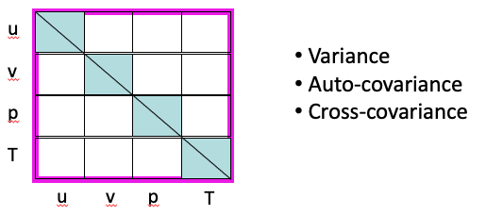
Background Term
Analysis: x
Start from x=x_{b}
Analysis increment: x-x_{b}
Background error covariance: B
Controls influence distance
Contains multivariate information
Controls amplitude of correction to background
For NWP, matrix is prohibitively large
Many components are modeled or ignored
Sequence of covariance model operators:
B = B_{p}B_{v}B_{h}S
S: variance
B_{h}: horizontal auto-correlations
B_{v}: vertical Auto-correlations
B_{p}: cross-correlations
Plus balance terms as needed

Slide 38
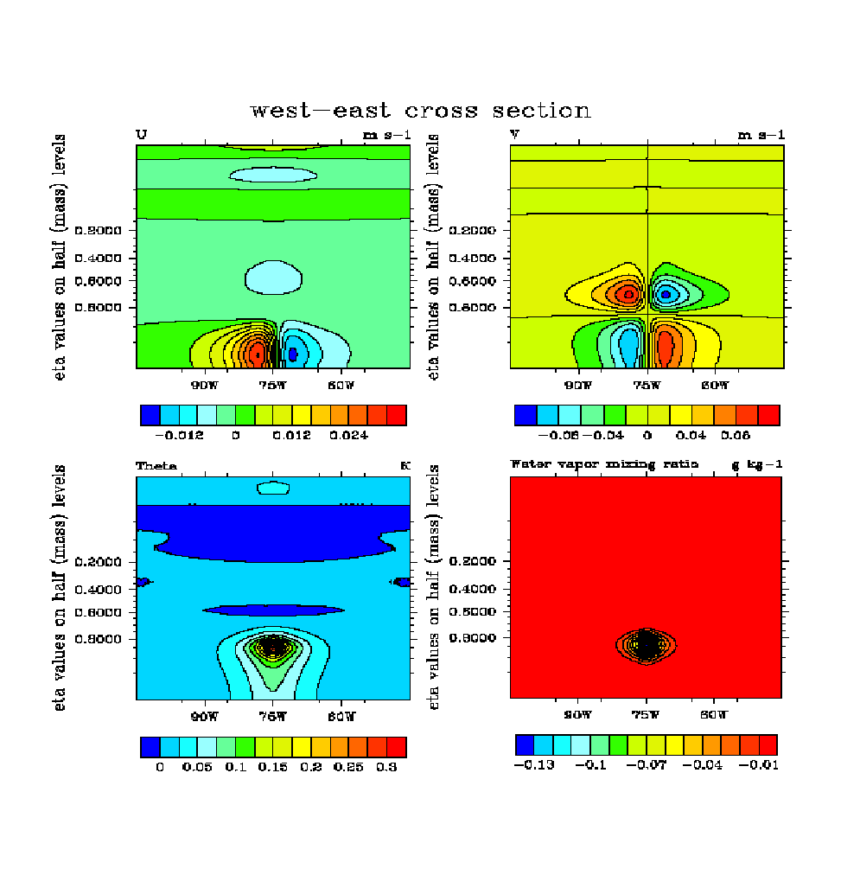
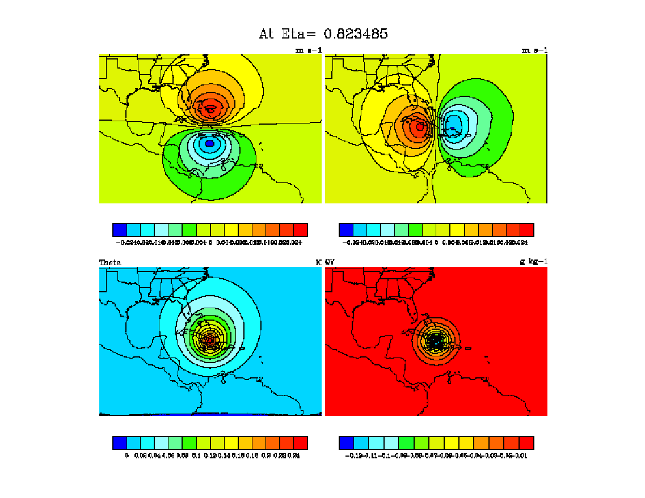
Single observation test using 3DVar
Analysis increments due to single observation
u
v
u
v
T
q
T
q
Reflection of static background error covariances:
Error, horizontal scale, vertical scale, univariable/cross-variable correlation
Notes:
Need copy figures from KJ’s directory (bluefire)

Slide 39
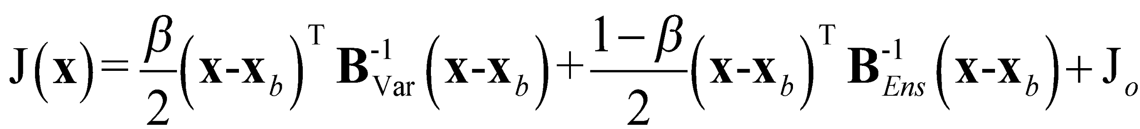
“Hybrid” Methods
EnVar: Variational methods using ensemble background error covariances
Hybrid: Variational methods that combine static and ensemble background error covariances
B_{Var}: (Static) background error (BE) covariance matrix(estimated offline)
B_{Ens}: (Flow dependent) background error covariance matrix (estimated from ensemble at each analysis time)
β: Associated with relative weightings of B_{Var} and B_{Ens}

Slide 40
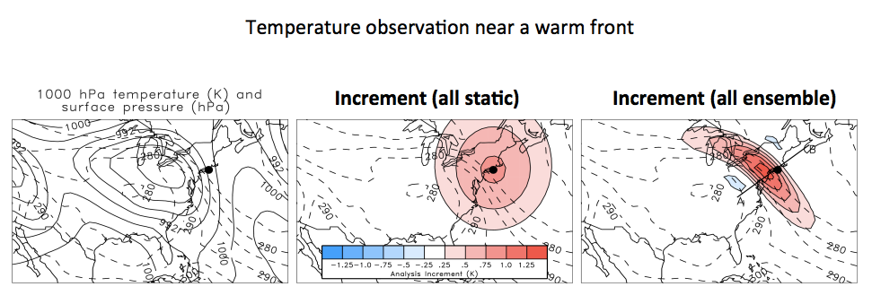
What Does B_{Ens} Do?
Allows for flow-dependence/errors of the day

Slide 41
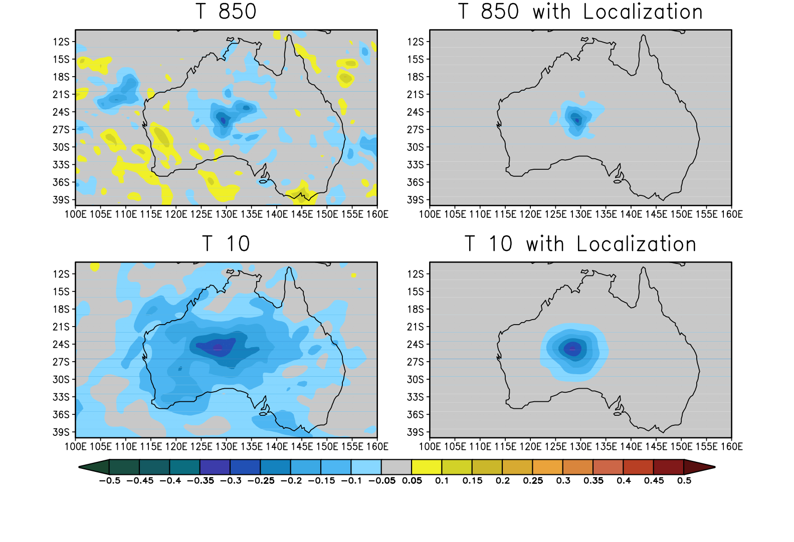
Limitation using ensemble
Need an ensemble that represents first guess uncertainty (background error)
In principle, any ensemble can be used. However, ensemble should represent well the forecast errors
This can mean O(50-100+) for NWP applications
Smaller ensembles have larger sampling error (rely more heavily on B_{Var})
Larger ensembles have increased computational expense
Localization of B_{Ens}

Slide 42
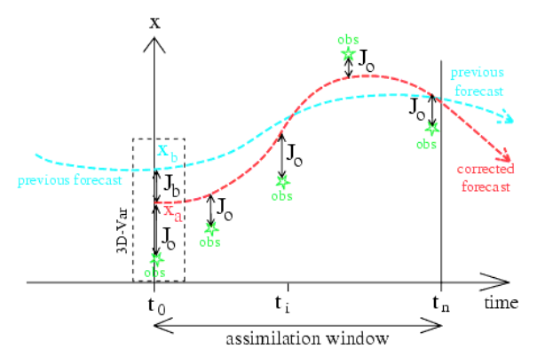
4D variational data assimilation (4DVar)
M is the forecast model
M^{T} is called the Adjoint of the linearized forecast model
Generalization of 3DVar for observations distributed in time
Analysis variable x defined at the beginning of time window
Find model trajectory minimizing the distance to observations

Slide 43

4DVar: Implicit Time Propagation of BE

Slide 44
Hypotheses Assumed
Linearized observation operator: the variations of the observation operator in the vicinity of the background state are linear:
for any x close enough to x_{b} :
H(x) –H(x_{b}) = H(x – x_{b}), where H is a linear operator
Non-trivial errors: B and R are positive definite matrices
Unbiased errors: the expectation of the background and observation errors is zero, i.e., < x_{b}-x_{t} >= < y-H(x_{t}) > = 0
Uncorrelated errors: observation and background errors are mutually uncorrelated i.e. < (x_{b}-x_{t})(y-H[x_{t}])^{T} >=0
Linear analysis: we look for an analysis defined by corrections to the background which depend linearly on background observation departures.
Optimal analysis: we look for an analysis state which is as close as possible to the true state in an r.m.s. sense
i.e. it is a minimum variance estimate
it is closest in an r.m.s. sense to the true state x_{t}
If the background and observation error pdfs are Gaussian, then x_{a} is also the maximum likelihood estimator of x_{t}

Slide 45







Data assimilation steps
Temperature anomaly correlation
Background
observation
OmB after QC
Verification/Assessment
Data Ingest
OmA
OmB after QC+cloud clearance
QC and/or bias correction
Minimization->analysis

Slide 46


Improving use of observations
Current GSI QC flags applied to ATMS channel 3 (50.3GHz)
Obs number
A more realistic background, QC and an improved DA algorithm -> Increase the use of satellite data in operations (green)
pass QC check
QC dependent on surface sensitive Tbs

Slide 47
Outline
Numerical Weather Prediction
Observations
Models
Data assimilation methods explained using Bayes Theorem
Components of data assimilation system
JEDI data assimilation system (used in the hands-on session)
GNSS Radio Occultation assimilation

Slide 48
Joint Effort for Data assimilation Integration (JEDI)
Definitions
JEDI: One system with multiple configurations for Earth system data assimilation
UCAR & Community
WRF
MPAS
ROMS
GFS
MIT GCM
SAR
LFRic
Air Force
HAFS
JEDI
NEPTUNE
Navy
MOM6
MERRA
GOCART
NOAA
CICE5
WW3
GEOS-Chem
NWM
RTMA
GEOS
NASA

Slide 49

Unified Forward Operator (UFO)
Forward operators simulate observations of specific instruments from geophysical model variables.
NRL
EMC
STAR
CYGNSS
UFO
GMAO
SMAP
ESRL/AOML
Aeolus
.edu
USAF/NCAR
UFO = ‘App Store’ of model-agnostic operators and QC filters that can be shared and compared
Notes:
Everybody can contribute to the development of a UFO and everybody can download a UFO. JCSDA provides the plumbing & ensures that UFOs are complete (data ingest, QC, obs. error), tested and run efficiently (high TLR).

Slide 50

Joint Effort for Data assimilation Integration (JEDI) system used in this workshop
JEDI is a collaborative effort to develop a next-generation unified data assimilation system for the Earth system, using advanced computing languages and techniques
OOPS: Object-Oriented Prediction System
UFO: Unified Forward Operator
IODA: Interface for Observation Data Access
BUMP: B matrix on an Unstructured Mesh Package

Slide 51
Outline
Numerical Weather Prediction
Observations
Models
Data assimilation methods explained using Bayes Theorem
Components of data assimilation system
JEDI data assimilation system (used in the hands-on session)
GNSS Radio Occultation assimilation

Slide 52

Radio Occultation with GNSS
basic measurement principle:
Deduce atmosphere refractive properties based on
precise measurement of phase delay and amplitude

Slide 53


Electromagnetic Propagation
The atmospheric refractive index: $n=\frac{c}{v}$ defines the speed of electromagnetic waves.
Under normal conditions, n ~ 1.00330 at the surface and exponentially decreases with height up to 60km.
Electromagnetic Propagation in the Atmosphere
Electromagnetic Propagation in the Atmosphere

Slide 54


Observables: Phase delay
ionosphere effects
tropospheric
effects
$$LC=\frac{{f_{1}^{2}L}_{1}−f_{2}^{2}L_{2}}{f_{1}^{2}−f_{2}^{2}}$$
Phase amplitude and delay
for GPS/MET occultation no 43 day 173

Slide 55

Radio Occultation Geometry
Profiling is obtained through the satellites movements
Notes:
… so once the orbits have been determined well it is possible to determine atmospheric profiles.
The lower right panel on this slide shows a birds-eye view of the CHAMP satellite in LEO. The white line indicates the ray to the GPS satellite, which is not shown and the white dot shows the location of the tangent point introduced in the top left panel.
As the tangent point descends through the atmosphere, the temperature profile is shown in the little panel to the right of the globe.
The temperature profiles are obtained in post processing.

Slide 56

Doppler shift
Illustration of light waves from a moving light source.
(From: NASA's Imagine the Universe)

Slide 57
Bending Angles Derivation
LEO
Bending angle 𝛂
impact parameter p = r n sin(𝜙)
receiver-measured
Doppler Frequency Shift
precise orbit
Doppler frequency shift
From Wickert 2016

Slide 58
Rays and Perigee Points

Slide 59
Atmospheric Refractivity
Atmospheric refractivity N = 10⁶(n-1)
dry air
partial pressure
water vapor
partial pressure
ionospheric effects
$N=7.760 {10}^{−5}\frac{P_{d}}{T}+3.739{ 10}^{−1}\frac{P_{w}}{T}$+ $7.040{ 10}^{−5}\frac{P_{w}}{T^{2}}−4.030{ 10}^{−1}\frac{N_{e}}{f^{2}}$

Slide 60
Radio-Occultation processing/modeling
Phase delays L¹ & L²
Processing/hypotheses
Precise orbit determination
Doppler shifts f_{d}¹ & f_{d}²
Snell Law
n_{GPS}sin𝜶_{GPS}=n_{LEO}sin𝜶_{LEO}
Bending angles 𝜶 ¹ & 𝜶 ²
Ionospheric Correction
n ~ 1/f ²
Bending angle 𝜶
Abelian Inversion
spherical symmetry
1D operator
2D
operator
Refractivity profile n
1D-VAR
prior information
1D operator
P, T, Q

Slide 61

Bending Angles Derivation
p₀ = r₀ n(r₀)
bending angle α
r
𝝷
LEO
From Wickert 2016

Slide 62





1D operator (Abel Inversion)
Elemental bending angle along the ray (from ray equation):
$$dα=\frac{1}{n}\left(\frac{∂n}{∂r}\right)rdθ+\frac{1}{n}\left(\frac{∂n}{∂θ}\right)\frac{dr}{r}$$
$$\left(\frac{∂n}{∂θ}\right)=0$$
Assuming spherical symmetry:
Which implies:
$$n r\sin{φ}=constant$$
$$x=nr$$
Total Bending:
$$α=−2p\int_{p}^{∞}{\frac{∂\ln{n}}{∂x}}\frac{p}{\sqrt{x^{2}−p^{2}}}dx$$

Slide 63

Bending Angle 1D Assimilation
Model refractivity is first computed on the model grid at perigee points.
Bending angles are computed by numerically evaluating the integral at the perigee points:
$$α(p)=−2p\int_{p}^{∞}{\frac{∂\ln{n}}{∂x}}\frac{p}{\sqrt{x^{2}−p^{2}}}dx$$
This observation operator is local, i.e. use one model profile
at perigee points, GNSSRO bending angle observations
are averaged along the rays.

Slide 64
Bending Angle 2D Assimilation
The ray equation from geometric optics is numerically solved.
The ray path from emitter to receiver is determined and the bending angle is evaluated from the initial and final ray directions.
The ray equation is a consequence of the Fermat principle:
The path between two points taken by a ray of light leaves to optical length stationary under a family of nearby points.

Slide 65





Ray-traycing (2D-operator)
n_{ij+1k+1}
n_{i+1j+1k+1}
1) Refractivity
n_{i+1j+1k}
$$n=f(P,T,Q)$$
n_{ij+1k}
$$dε$$
2) Ray Equation
$$n\vec{∇}n$$
n_{i+1jk+1}
$$\frac{d^{2}\vec{r}}{{dτ}^{2}}=n\vec{∇}n$$
n_{i+1j+1k}
3) Bending angle
$a=\int_{GPS}^{LEO}{dε}$
n_{ijk}
n_{i+1jk}

Slide 66
Bending Angle 2D Assimilation
2D Bending Angle assimilation better account for horizontal gradient and tend to perform better in the lower troposphere.
The differences between 1D/2D Bending Angle assimilations are not (yet) statistically significant.

Slide 67

Bending angle simulation using multiple operators
nbam

Slide 68
Operational GNSS RO Data Assimilation
Compared to other satellite data, GNSS RO data has higher vertical resolution.
GNSS RO data can be assimilated without bias correction and contribute to remove biases from other data sources.

Slide 69
Operational GNSS RO Data Assimilation
2006: first operational assimilation of COSMIC observations at ECMWF (1D-bending angle), then 2D in 2007.
1D bending angle assimilation now operational at UK Met Office, NCEP, US Navy, Meteo-France, Environment Canada, Japan Meteorological Agency, Taiwan Central Weather Bureau and Deutscher WetterDienst.

Slide 70

COSMIC-II Constellation
12 Low orbit satellites
12,000 soundings every day
COSMIC is a US-Taiwan cooperation. Launch January 2019.

Slide 71
Challenges
Improved GNSS receivers, like on COSMIC2, will penetrate deeper in the low atmosphere, nearly down to the surface:
Anomalous/Multipaths propagation mostly due to the presence of humidity gradient
Observation error estimation

Slide 72

Anomalous Propagation

Slide 73
Multipaths propagation
Fermat’s principle states that the ray path from an observer at A
to a point B in space is a stationary path of optical length. For example, along a sun-baked road, the temperature of the air is warmest near the road and decreases with height, so that the index of refraction, n, increases in the vertical direction. For an observer at A, the curved path has the same optical path length as the straight line. Therefore, he sees not only the direct line-of-sight image of the tree top at B, but
it also appears to him that the tree top has a mirror image at C.
http://wwwf.imperial.ac.uk/~dholm/classnotes/HolmPart1-GM.pdf

Slide 74
JEDI Unified Forward Operator (UFO) for GNSSRO
UFO
Model state variables
Atmosphere
Marine
…
Radiosonde
Aircraft
GNSSRO
Radiance
…
“Local” refractivity
GDAS¹ 1D bending angle (NCEP, NASA)
ROPP² 1D bending angle (NRL)
ROPP 2D³ ray-tracing bending angle (ECMWF)
MetOffice 1D bending angle (UK MetOffice)
¹GDAS: following NCEP Global Data Assimilation System implementation but code is adapted and refactored to fit JEDI structure
²ROPP: Radio Occultation Processing Package
³ 2D ray-tracing: The ray trajectory equation is solved on 2D occultation planes

Slide 75



JEDI Unified Forward Operator (UFO) for GNSSRO
GNSSRO UFO - Operators
 | BndGSI | BndROPP1D | BndMetOffice | BndMetOffice | BndROPP2D | BndROPP2D | RefNCEP | RefMetOffice
Operation | NCEP NASA | NRL | Met Office | Met Office | ECMWF | ECMWF | NCEP | Met Office
Assimilated Observable | Bending angle |  |  |  |  |  | refractivity
 | Vertical integral |  |  |  |  | take account of the real limb nature of the measurement; solve a set of ray path equations | Local refractivity operator
Equation(s)
Reference | Cucurull et al. 2013 | Healy and Thepaut 2006 |  | Burrows et a. 2014 |  | Healy et al. 2007 | Cucurull et al. 2007 | Buontempo et al. 2008

Slide 76
JEDI Unified Forward Operator (UFO) for GNSSRO
GNSSRO UFO - (flexible) Configurable
 |  | option1 | option2 | option3 | option4
operator | Bending angle | BndNBAM | BndROPP1D | BndROPP2D | BendMetOffice
 | refractivity | RefNCEP | RefMetOffice
quality control | Background departure | Generic | RONBAM
 | Super refraction | NBAM | ECMWF | CDAAC observation-based (to be added)
 | Profile QC | LSW | 1DVar
Observation error | In obs file | NBAM | NRL | ECMWF | Read in from file
Observation filter | Mission id/ gnss id | Height/lat | rising/setting | Processing_center | and more

Slide 77
Questions/Comments?
vandenb@ucar.edu

Slide 78
Reference
Data Assimilation Concept and Methods (Bouttier & Courtier, 1999)
GSI Tutorial Lectures:
- Fundamentals of Data Assimilation (Tom Auligne,2011) (Kyao Ide, 2017)
Aerosol Data Assimilation (Zhiquan Liu)
Introduction to Data Assimilation (Mike Fisher, 2015) (Javier Amezcua, 2018)
And other theory books about data assimilation

Slide 79

Airborne Radio Occultations
Current reporting commercial flights
Expected RO profiles locations
Observing System Simulation Experiments

Slide 80
Balloon borne radio occultations

Slide 81



Fractional Impact
TRAVEL BAN March 11
AIRCRAFT
Spire May 13
GNSSRO
COSMIC-2 March 25

